Slide 1
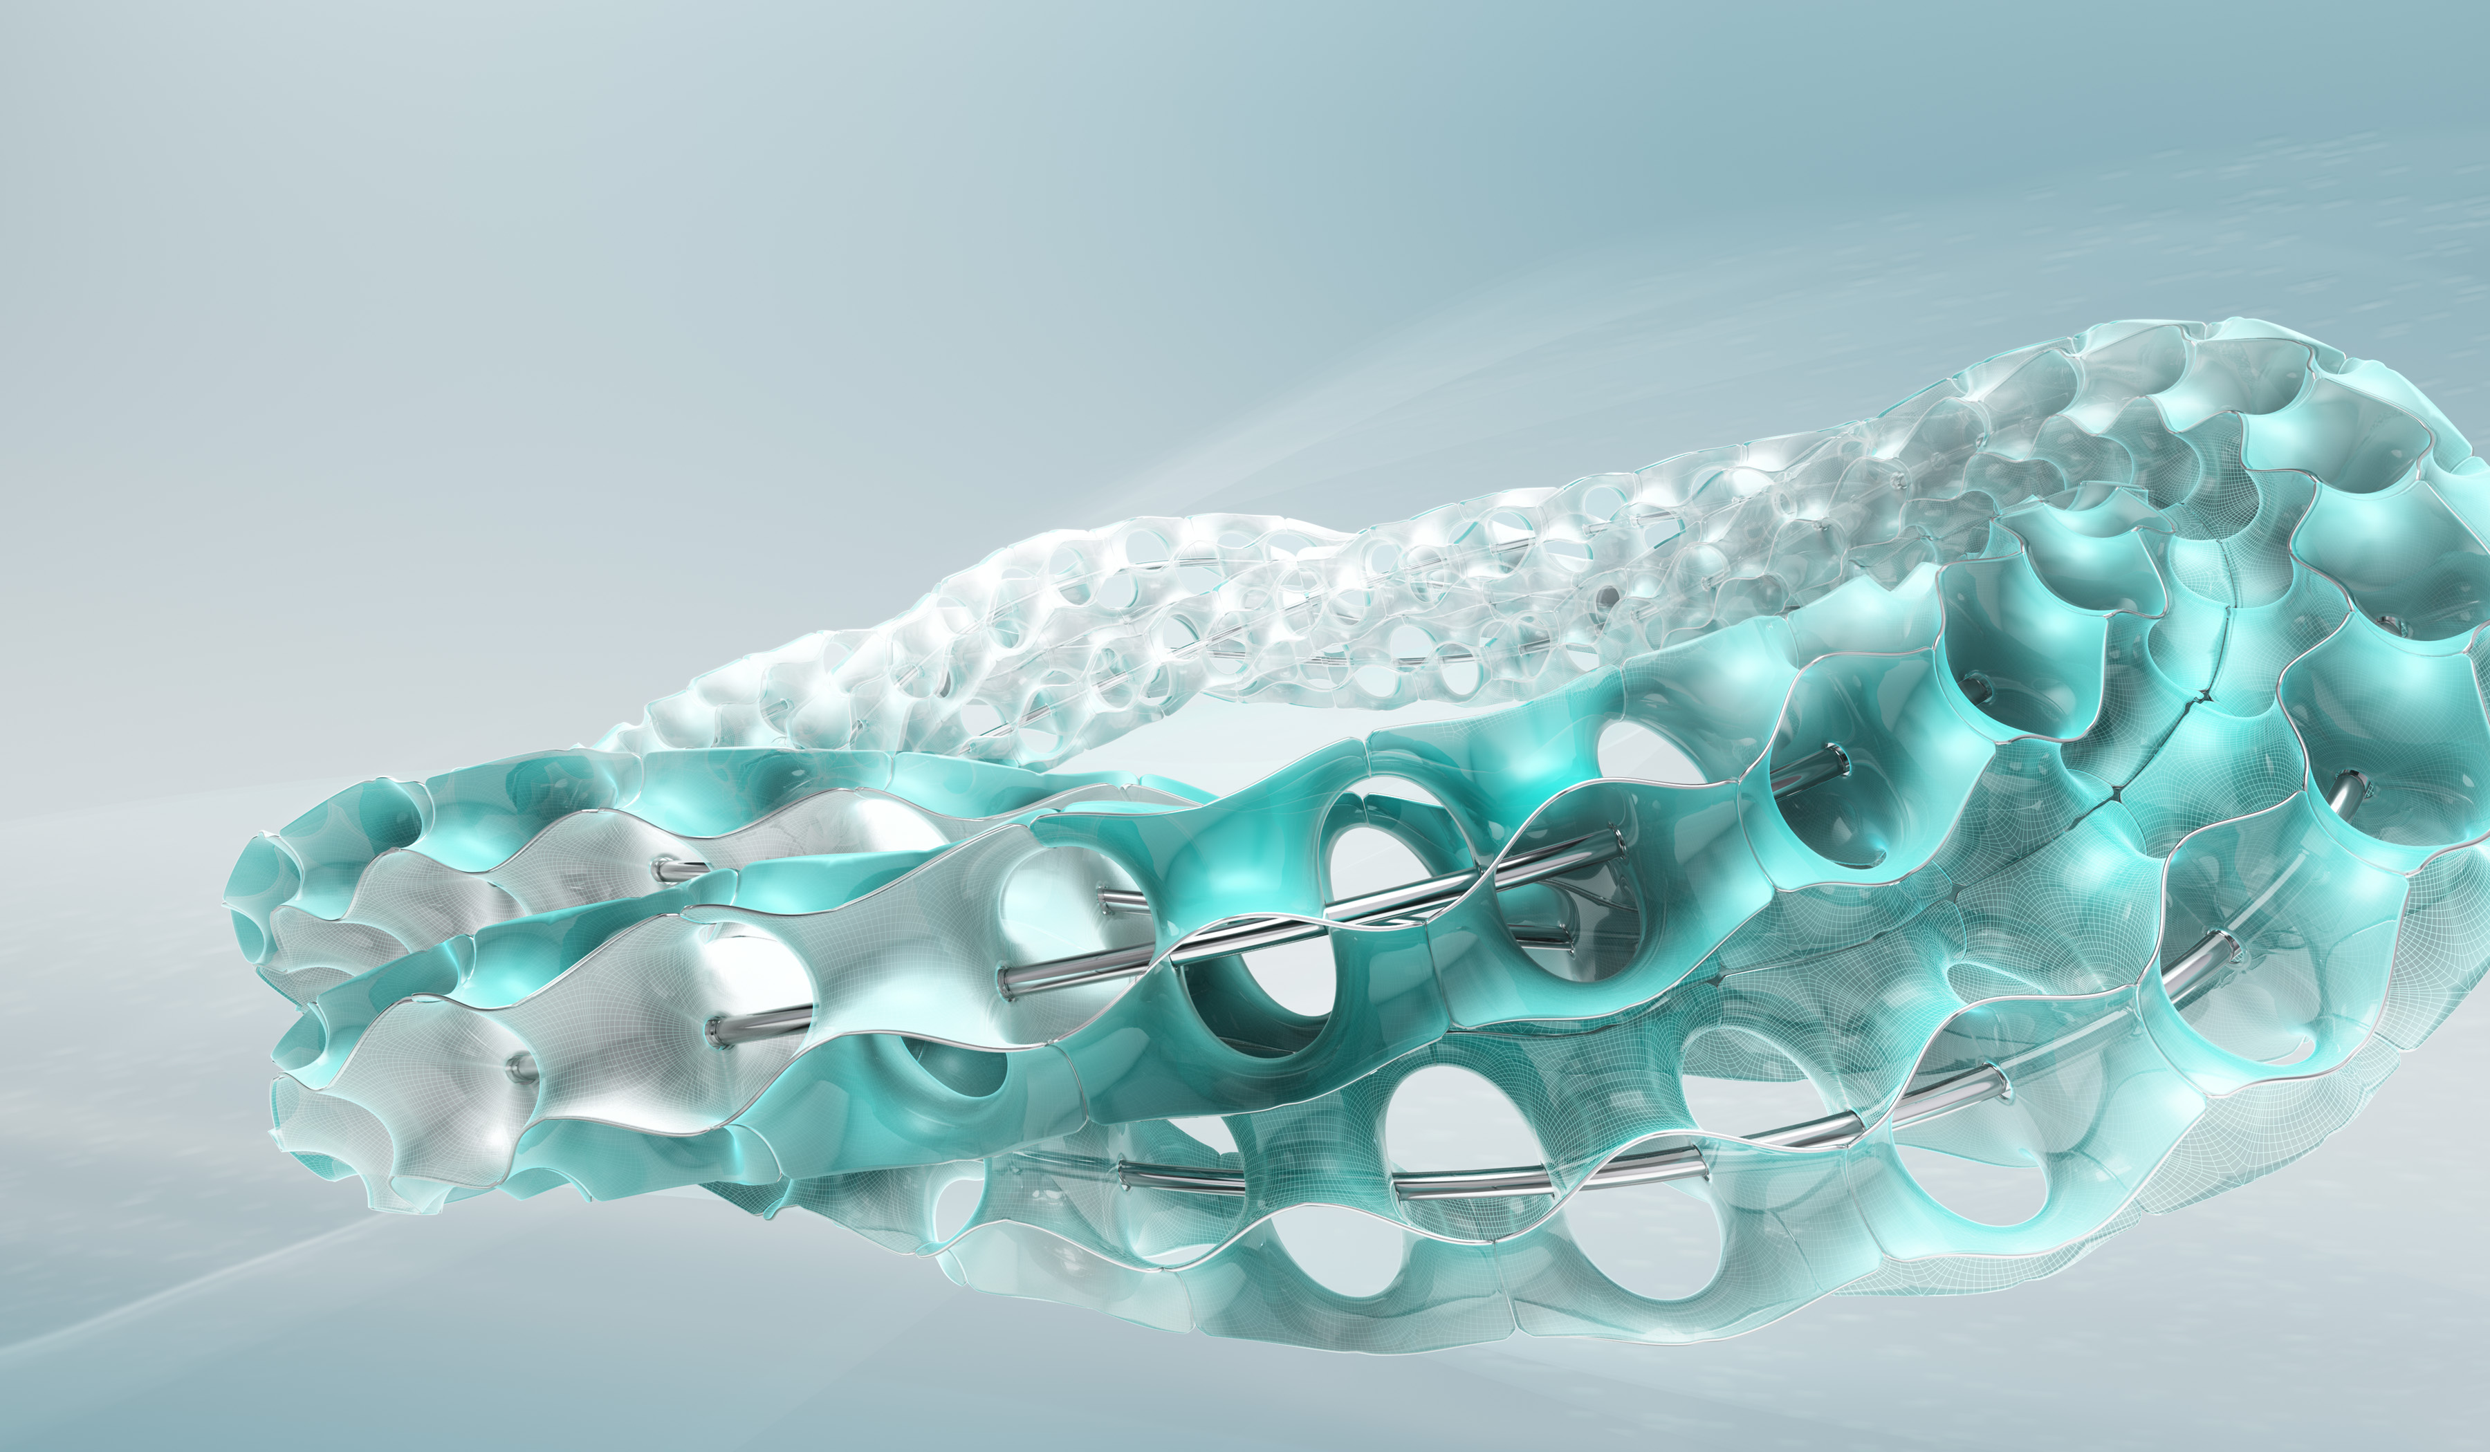

Rambus
Oct 31-Nov 4, 2016
Admin Training
& Requirements Mapping
Sara Murray
PLM Consultant, Razorleaf Corp.

Slide 2
TITLE HERE
January 5, 2016

Slide 3
Rambus Training Agenda, Day 1
Topic | Attendees
Introduction, Concepts | Core Team, Sponsors & Stakeholders
Using Autodesk Fusion Lifecycle | Admins
LUNCH
Site Administration | Admins
Review & Wrap Up | Admins & PM

Slide 4
Introduction
Introductions (Name, Role)
Executive Sponsor Welcome / Introduction
Role of Core Team from Rambus
Role of Other Approvers & Participants

Slide 5

Attendees: Core Team Plus Sponsors
Cross-functional group of 8-10 people from the client’s organization responsible for the successful implementation of Fusion Lifecycle.
1 Executive Sponsor
1 IT Sponsor
1 Internal Project Manager
2 Fusion Lifecycle Administrators
3-4 Subject Matter Experts
Tips for Selecting Core Team:
Select implementation team wisely: select members who will promote positive changes within your organization and offer productive insight
Executive sponsors: allows faster decision making during implementation, signals the importance of the implementation internally, creates a climate for success
Admin Backups: good practice to have at least 2 people who can effectively admin the site
Multiple Departments: involving multiple departments can spur faster adoption
Notes:
Attendees:
Core Team Plus Sponsors: group of 8-10 people from the client’s organization responsible for the successful implementation of Fusion Lifecycle. This cross-functional team consists of:
Executive Sponsor
IT Sponsor
Internal Project Manager
PLM Admins (2)
Subject Matter Experts (3-4)

Slide 6
Rambus Agenda, 10/31 – 11/11
Date | Topic | Attendees
10/31 – 11/2 | Training | Admins & PM
11/3 – 11/4 | Mapping | Core Team + Stakeholders (+ Sponsors)
11/7 | Mapping Finalization | Consultant
11/8 | Configuration: Items & BOMs | Consultant
11/9 | Configuration: Change Mgmt | Consultant
11/10 | Configuration: Doc Mgmt | Consultant
11/11 | Configuration: Product Mgmt and Preliminary Config Review | Consultant and Admins & PM
Notes:
PM = Project Manager
Consultant is onsite during dates in white. Consultant is offsite during greyed dates.

Slide 7
Rambus NPI Agenda, 6/9 – 6/24
Time | Topic | Attendees
6/9 | Configuration | Consultant
6/10 | Create Wrap Up PPT | Consultant
6/10 | Final Testing | Core Team
6/13 6/14 6/15 | Finalize Config Wrap Up & Handover Begin UAT Support | Core Team
6/14 – 6/24 6/20 – 6/24 | Pilot Run UAT Support (8 hours) | Core Team + Stakeholders Consultant
Notes:
PM = Project Manager

Slide 8
Admin Training Introduction
Purpose and Objectives
Materials
Quick Reference Guide
“Every Expert was once a Novice”
Intro & Overview Slides
Autodesk Fusion Lifecycle Training Tenant URL
Ground Rules
Notes:
Purpose: Get a solid base on which to build. Next 4 days is for getting a good base. Fusion Lifecycle is quick, is expandable, is iterative.

Slide 9
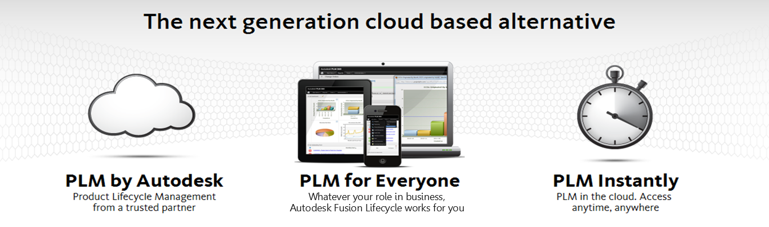
What is Autodesk Fusion Lifecycle?
http://www.autodeskfusionlifecycle.com/

Slide 10
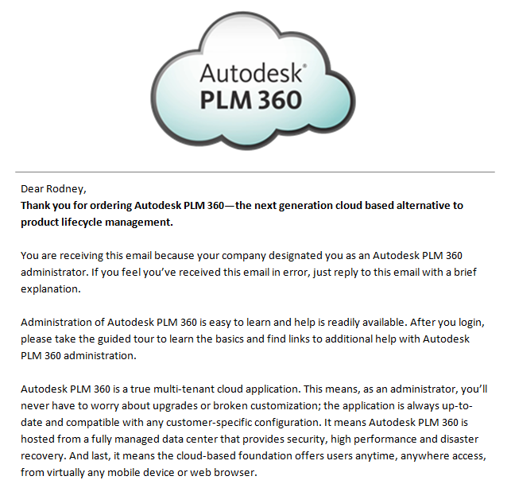

Cloud based Software as a Service
True multi-tenant cloud application
No worry about upgrades or broken customization
Always up-to-date and compatible with configurations
Hosted from a fully managed data center:
Security
High Performance
Disaster Recovery

Slide 11
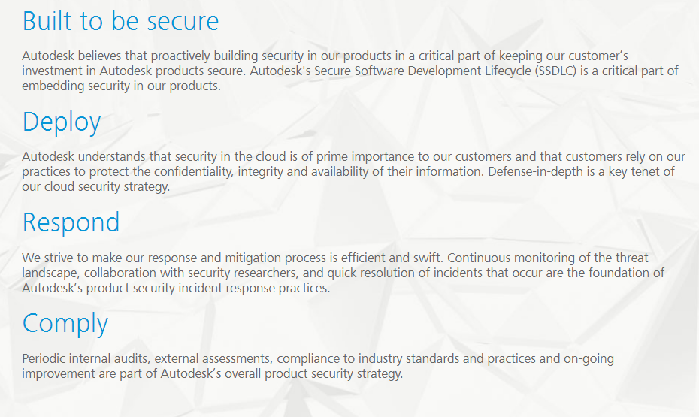
PLM in the Cloud
http://www.autodesk.com/trust/overview
Notes:
Autodesk has been delivering Software as a Service (SaaS) applications, such as Autodesk® Buzzsaw®, since 1999.

Slide 12
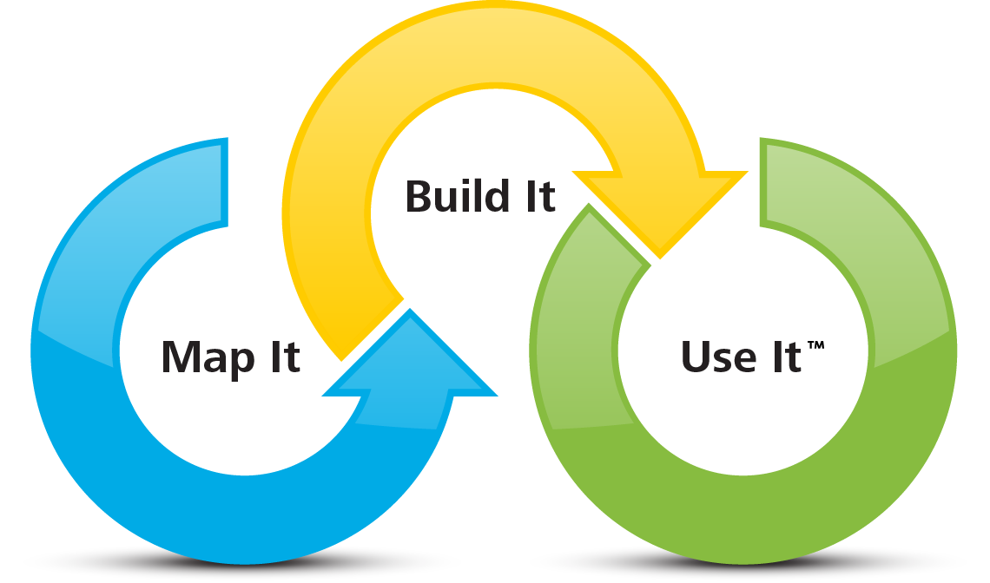
Methodology
Rapid and Incremental Implementation

Slide 13


PLM vs. PDM
PLM
PDM
Notes:
Product Lifecycle Management vs. Product Data Management. PDM can be thought of as version control of documents and design files. PLM is a strategy or approach that integrates people, data, processes and business systems in support of a product from inception to retirement. Autodesk Fusion Lifecycle is a tool for implementing PLM in your organization.

Slide 14
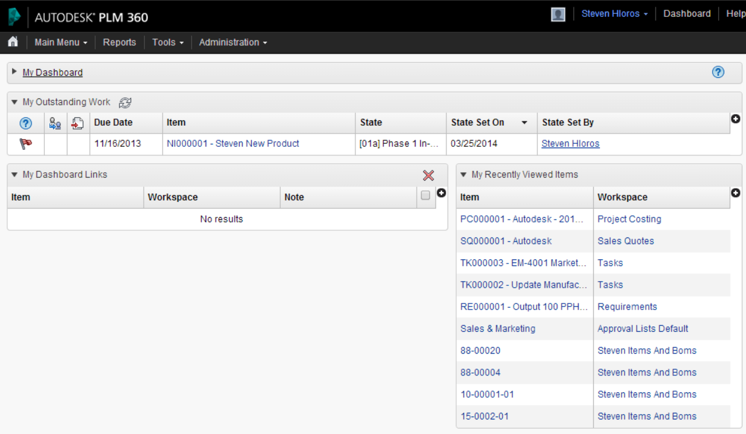
Autodesk Fusion Lifecycle Basics
Autodesk Fusion Lifecycle Terminology
Tenant: Rambus Autodesk Fusion Lifecycle Environment in the Cloud (one for Training, one for Production)

Slide 15
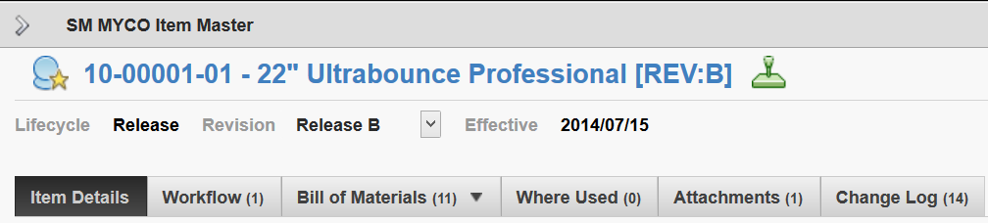
Autodesk Fusion Lifecycle Basics
Autodesk Fusion Lifecycle Terminology
Workspace: Building block or module in which to store, view, and work with data for a particular business function. Each workspace contains different Tabs that capture different pieces of information relevant to that business function.

Slide 16
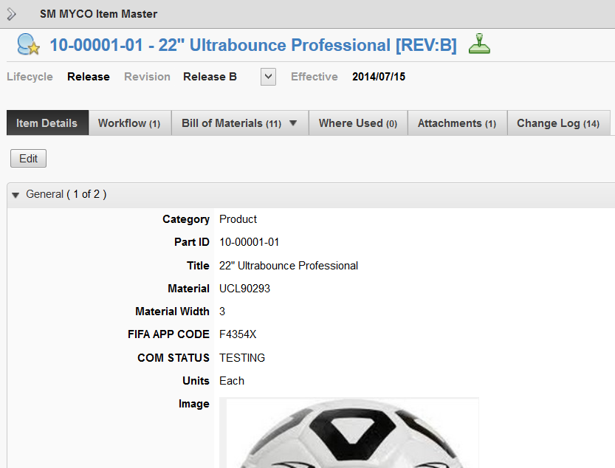
Autodesk Fusion Lifecycle Basics
Autodesk Fusion Lifecycle Terminology
Item: A unique record maintained in an Autodesk Fusion Lifecycle workspace about a specific object in that workspace (could be a product, person, organization, asset, and more)

Slide 17
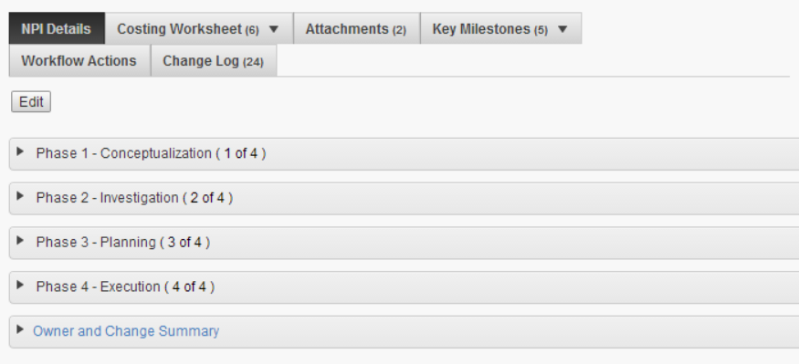
Autodesk Fusion Lifecycle Basics
Autodesk Fusion Lifecycle Terminology
Section: Expandable/Collapsible area on the first tab in a workspace that contains related pieces of information

Slide 18
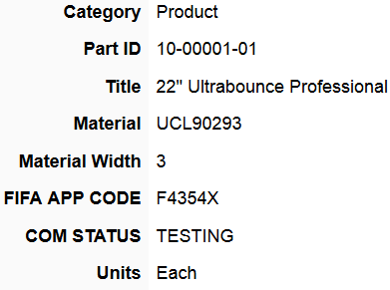
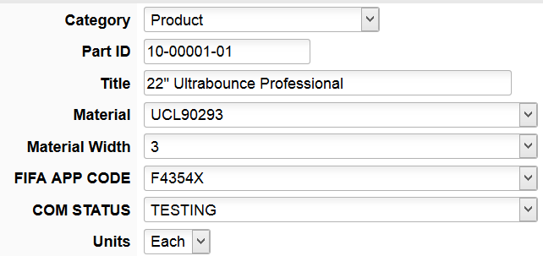
Autodesk Fusion Lifecycle Basics
Autodesk Fusion Lifecycle Terminology
Field: Data entry area within a section that contains data relevant to a specific item
Notes:
View mode on left vs. edit mode on right

Slide 19
Autodesk Fusion Lifecycle Basics
Autodesk Fusion Lifecycle Terminology
Item Descriptor: A user-defined concatenation of workspace fields used to identify and describe an item uniquely

Slide 20
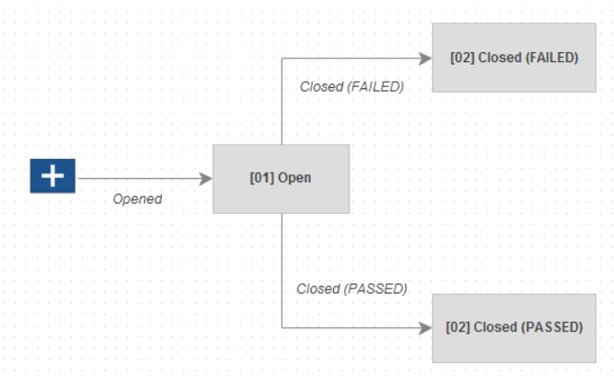
Autodesk Fusion Lifecycle Basics
Autodesk Fusion Lifecycle Terminology
Workflow: The defined process through which certain Autodesk Fusion Lifecycle items pass. As an item progresses through the actions in a workflow (transitions), the state of the item in a workflow changes.

Slide 21

Autodesk Fusion Lifecycle Basics
Autodesk Fusion Lifecycle Terminology
Applications: Applications are a collection of pre-built workspaces and workspace relationships used to manage different business processes that can be downloaded at anytime from the App Store
Notes:
Can also go into tenant and show path to get there and scroll down through all the offerings.

Slide 22
Autodesk Fusion Lifecycle Reviewing Basics
Autodesk Fusion Lifecycle Terminology
Tenant
Workspace
Item
Section
Field
Item Descriptor
Workflow
Application

Slide 23
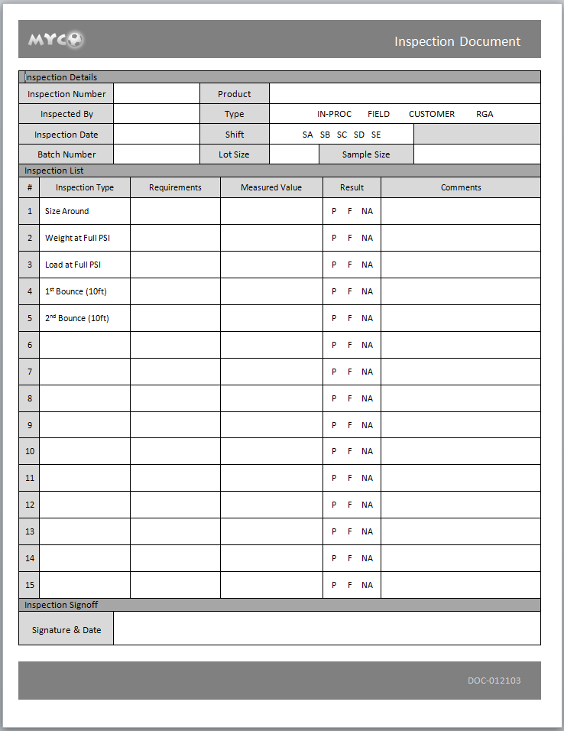
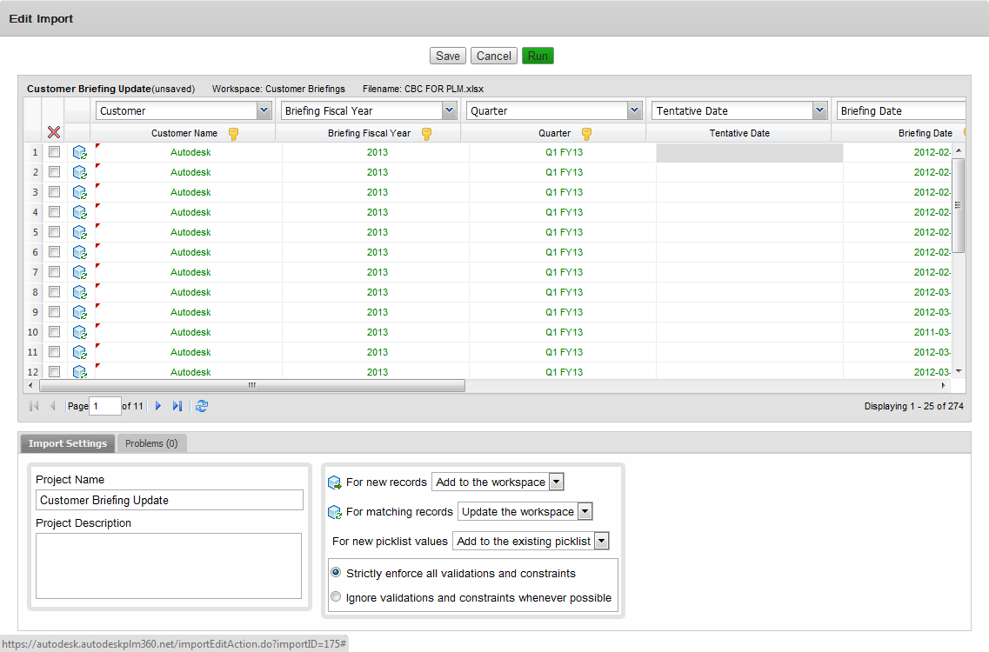





Getting Data into Fusion Lifecycle
1
Manual Entry
2
Excel Import
3
PLM 360 Connect,
Powered by Jitterbit
Integrate corporate systems, databases, applications & cloud tools
Migrate data from legacy systems
Consolidate disparate data from multiple locations and systems

Slide 24
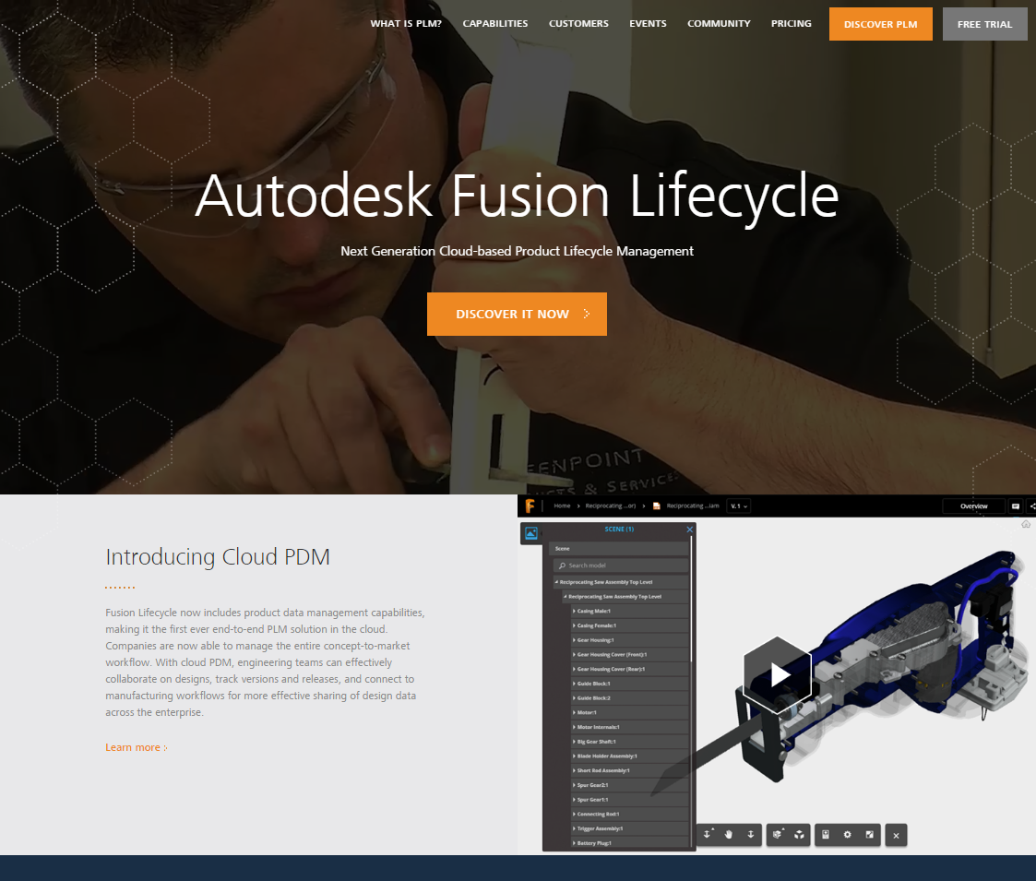
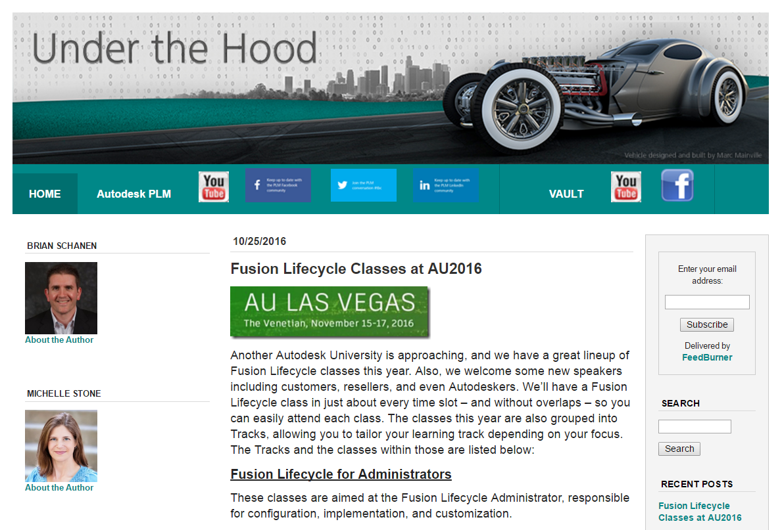
Fusion Lifecycle Resources
General Information
Fusion Lifecycle Home Page
Blogs
Under the Hood Blog
Autodesk® Fusion Lifecycle with Mike Watkins
Support
Fusion Lifecycle Help
Fusion Lifecycle Forum
PLM Talk (bi-weekly webinars)
PLM TV (You Tube)

Slide 25
Fusion Product Innovation Platform Video
https://www.youtube.com/channel/UConxSFGRWQa-6KExt1C6kQQ
Notes:
Another option: Autodesk and NetSuite Transforming Manufacturing in the Cloud (3-minute video):
http://www.youtube.com/watch?v=3aJaWSIMAvw

Slide 26

Autodesk is a registered trademark of Autodesk, Inc., and/or its subsidiaries and/or affiliates in the USA and/or other countries. Autodesk reserves the right to alter product and services offerings, and specifications and pricing at any time without notice, and is not responsible for typographical or graphical errors that may appear in this document.

